Slide 1
Foundations of Modern Software Systems
Module-2, Lecture-5
Instructor: Piyush Goel
N.M.A.M. Institute of Technology

Slide 2
Recap - Lecture - 4

Slide 3
Data Types: Storage Systems
MySQL - https://dev.mysql.com/doc/refman/8.0/en/data-types.html
MongoDB - https://www.mongodb.com/docs/mongodb-shell/reference/data-types/
SQLite - https://www.sqlite.org/datatype3.html

Slide 4
Storage - Fundamentals
Structuring (Modeling) & Querying
Databases
Types
Use-Cases
Object Storage

Slide 5
Storage - Fundamentals - Modeling
Sample Dataset
Names = (Cristiano Ronaldo", "Lionel Messi", "Haalaand", "Mohamed Salah", "Thomas Muller")
Club = ("Manchester United", "PSG", "Manchester City", "Liverpool", "Bayern Munich")
Country = (Portugal, Argentina, Norway , Egypt, Germany)

Slide 6
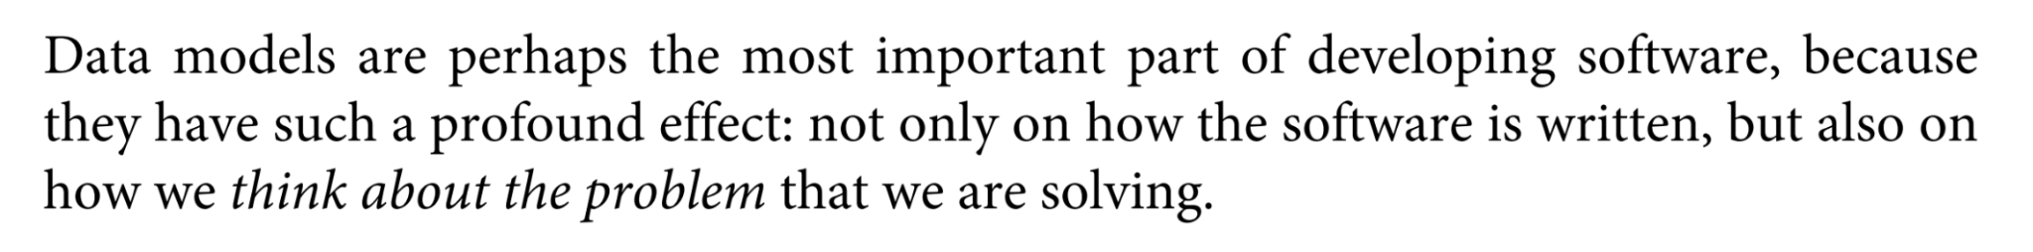
Storage - Fundamentals - Modeling
- Martin Kleppmann, Designing Data Intensive Applications
- @martinkl
A strong handle on data modeling will help you in your career!
Object Oriented Design
API Design
Data Structures

Slide 7
Storage - Fundamentals - Modeling
Record Identification? Keys?
Candidate Keys
Primary Keys
Read up on UUIDs - https://en.wikipedia.org/wiki/Universally_unique_identifier

Slide 8
Storage - Fundamentals - Modeling
What we have just discussed is Schema?

Slide 9

Storage - Fundamentals - Modeling

Slide 10
Storage - Fundamentals - Modeling
Join Algorithms? *
Homework
* Will strengthen your knowledge of data-structures!

Slide 11
Storage - Fundamentals - Modeling
Data Modeling Paradigms
Relational
Non-Relational
Document Oriented
Key-Value
Columnar
Graph
Time-Series

Slide 12
Storage - Fundamentals - Modeling - Relational
Relational
Model Data as a collection of “entities” and their “relationships”
Entities identified through Keys
Relationships:
One to One
One to Many
Many to Many
Tables for Entities, and Relationships.
Objects represented using “Joined” entities.

Slide 13
Storage - Fundamentals - Modeling - Relational
Non-Relational
Model Data as Self-Contained Objects
Identified by Keys or Identifiers
What kind of Data Structures do they model?
No concept of Joining as objects are self-contained

Slide 14
Storage - Fundamentals - Modeling
What are the pros, and cons of Relational and Non-Relational Modeling?
Homework

Slide 15
Storage - Fundamentals
Querying

Slide 16
Storage - Fundamentals - Querying
Declarative
Structured Query Languages (SQL)
XQuery (XPath)
SPARQL
Cypher
Imperative
Not really popular in data storage ecosystems.

Slide 17
Lecture - 5

Slide 18
Storage - Fundamentals
Structuring (Modeling) & Querying
Databases
Types
Use-Cases
Object Storage

Slide 19
Storage - Fundamentals - Databases
Relational
MySQL
Oracle
PostgreSQL
Aurora (Amazon)
Non-Relational
Data-Model Driven
“SchemaLess”
SQLite
“Enforced Schema”

Slide 20
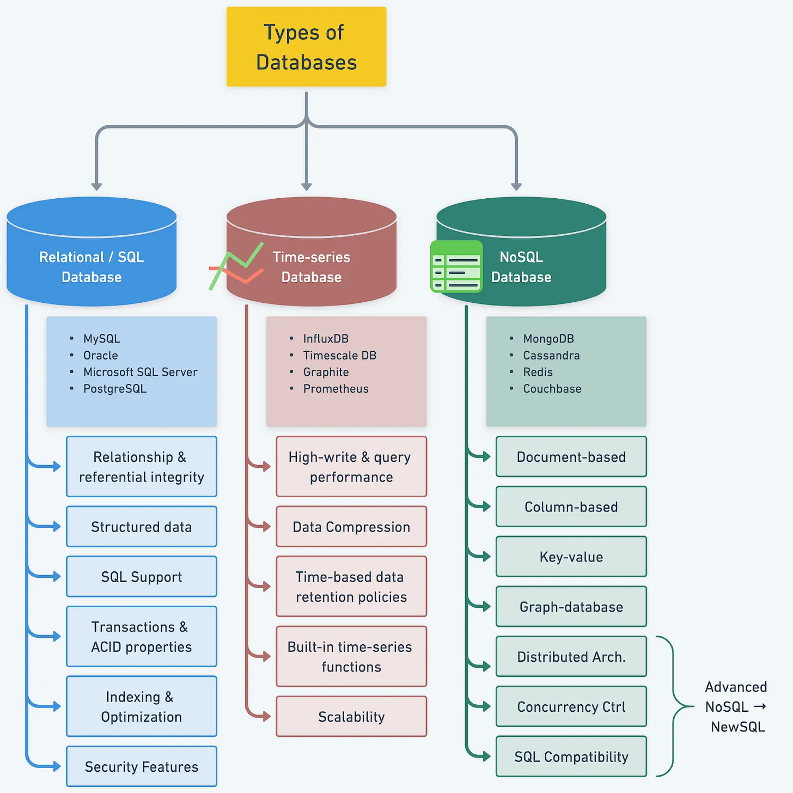
Storage - Fundamentals - Databases
* https://blog.bytebytego.com/p/understanding-database-types

Slide 21
Storage - Fundamentals - Databases
What would be your choice of database if you have to choose one?

Slide 22
Storage - Fundamentals - Databases
Relational Databases are here to stay!

Slide 23
Storage - Fundamentals - Databases
Relational Databases are here to stay!
Database Rankings - https://stackshare.io/mysql
* A funny take on this - https://www.youtube.com/watch?v=b2F-DItXtZs&t=233s&ab_channel=gar1t
* Contains illicit language.

Slide 24
Storage - Fundamentals - Databases - Relational
MySQL for reference
Model Data as a collection of “entities” and their “relationships”
Records identified through Keys (Candidate, Primary)
Interfacing through Structured Query Language (SQL)

Slide 25
Storage - Fundamentals - Databases - Relational
Structured Query Language (SQL)
Data Definition Language (DDL)
Data Manipulation Language (DML)
Data Query Language (DQL)
Examples
Using the Sample data available here - https://github.com/datacharmer/test_db

Slide 26
Storage - Fundamentals - Databases - Relational
Structured Query Language (SQL)
DDL
User Management
Access Management
Database Creation
Table Creation
DML/DQL
Insert, Updates, Deletes
Query
Formal Modeling as Relational Algebra (Set Operations)
Null - A special marker to represent “Information Not Available”

Slide 27
Storage - Fundamentals - Databases - Relational
Query Processing

Slide 28
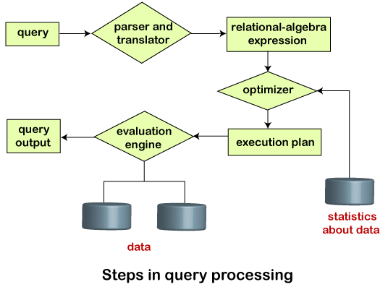
Storage - Fundamentals - Databases - Relational

Slide 29
Storage - Fundamentals - Databases - Relational
Normalised Forms
Unnormalised Forms
1st Normal Form
2nd Normal Form
3rd Normal Form
Denormalisation
Heavy Normalisation leads to Join computation at runtime.
Leads to performance degradation.
Denormalisation to improve.

Slide 30
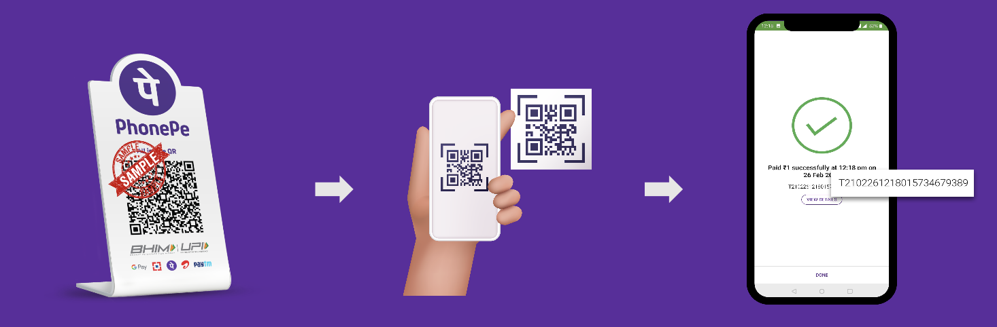
Storage - Fundamentals - Databases - Relational
How does money move from one account to another?

Slide 31
Storage - Fundamentals - Databases - Relational
How does money move from one account to another? (John → Jane), $50
Check balance in account of John
If (balance > money to transfer)
Deduct balance in John’s account by $50
Increase balance in Jane’s account by $50
Give Confirmation to both John & Jane.
Show Error - “Balance Low”
What if there is a network error in the meantime?

Slide 32
Storage - Fundamentals - Databases - Relational
Transactions
A group of operations/tasks that should be operated in sequence to accomplish a unit of work.
Either perform all of them or go back to the initial state.
Else we will end-up creating or destroying money! =)
Check balance in account of John
If (balance > money to transfer)
Deduct balance in John’s account by $50
Increase balance in Jane’s account by $50
Give Confirmation to both John & Jane.
Show Error - “Balance Low”

Slide 33
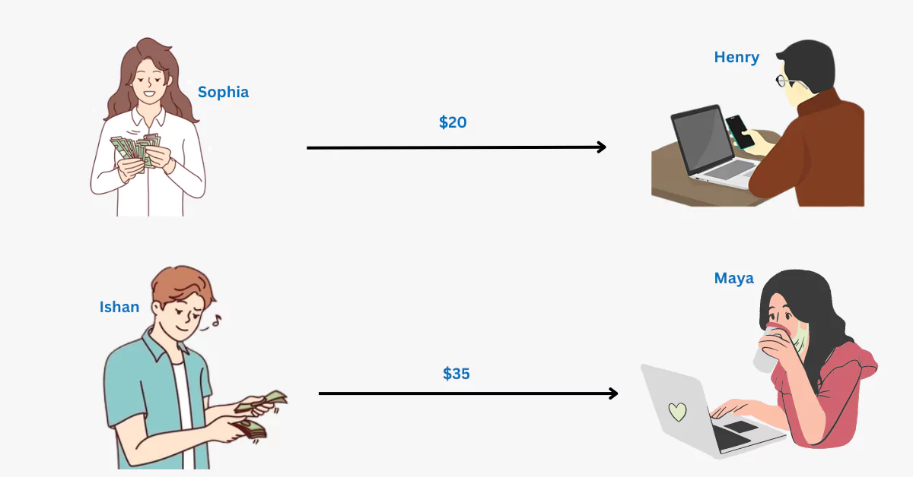
Storage - Fundamentals - Databases - Relational
* https://thinkinfi.com/what-are-database-transactions-with-example/

Slide 34
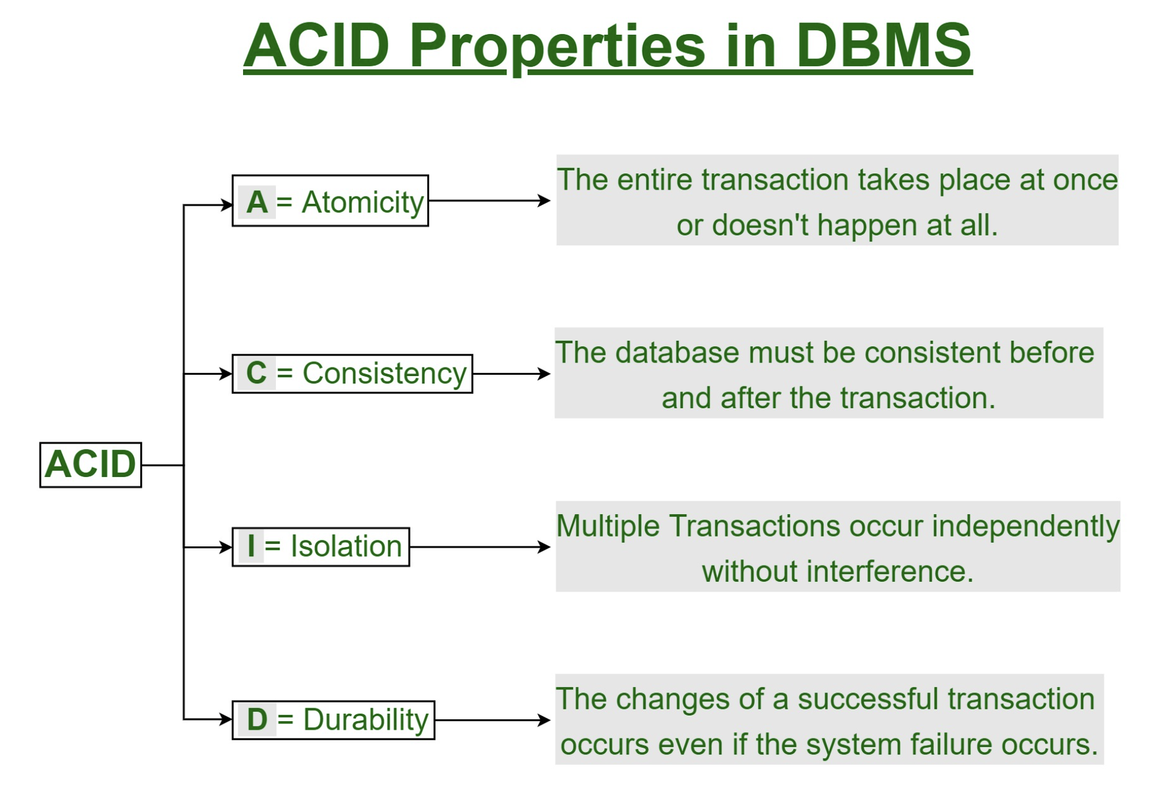
Storage - Fundamentals - Databases - Relational
Transactions - ACID
Atomicity
Consistency
Isolation
Durability

Slide 35
Storage - Fundamentals - Databases - Relational
How do we speed-up the execution of queries?

Slide 36
Storage - Fundamentals - Databases - Relational
Indexes

Slide 37
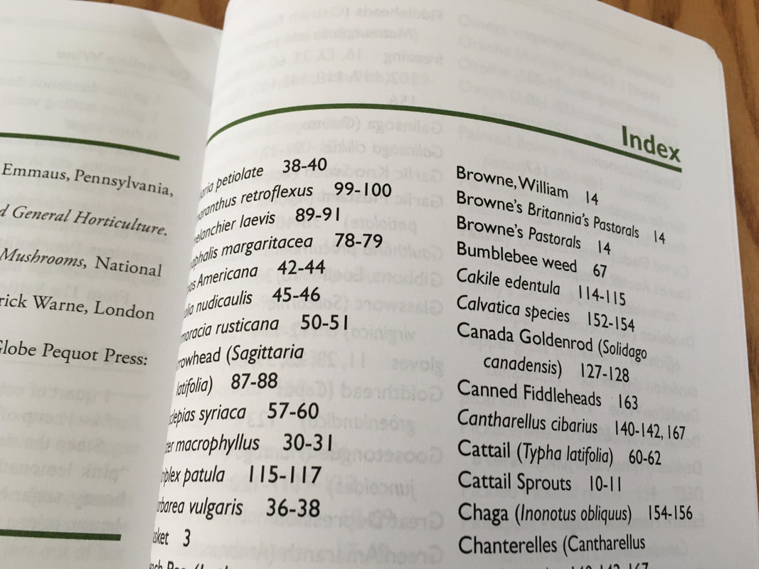
Storage - Fundamentals - Databases - Relational
Indexes

Slide 38
Storage - Fundamentals - Databases - Relational
Index Data Structures
B-Trees
Bitmaps
Range Trees
Hash Indexes

Slide 39
Storage - Fundamentals - Databases
Prof. Andy Pavlo’s Course on Databases
https://www.youtube.com/playlist?list=PLSE8ODhjZXjbj8BMuIrRcacnQh20hmY9g

Slide 40
Questions

